Slide 1
Incident Response and Recovery
System security certified practitioner

Slide 2
Scope
Incident Handling
Forensic Investigations
Business Continuity
Incident Response Toolkit
Identify
Protect
Detect
Respond
Recover

Slide 3
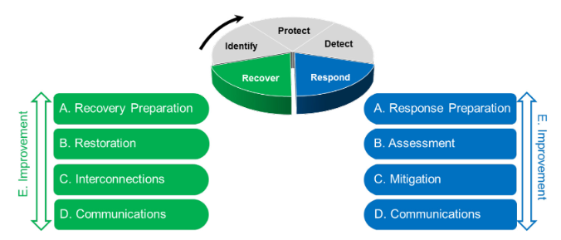
Incident Handling
Components of Respond and Recover Functions
Notes:
Efficient and effective response to and recovery from a cyber incident by organisations are essential to limiting any .related organisational risks.

Slide 4
Forensic Investigation
identify first responder best practices during forensic investigation activities
identify best practices for evidence handling during forensic investigation activities
describe characteristics and best practices of chain of custody during forensic investigation activities
identify best practices for preservation of scene during forensic investigation activities

Slide 5
Business Continuity
Planning, preparatory and related activities to ensure critical business functions
Staff training
Table-top simulations
Test backup/recovery procedures regularly
Review and update plans
Continue to operate despite serious incidents or disasters
Will be recovered to an operational state within a reasonably short period
Failing to plan is planning to fail – General Dwight Eisenhower

Slide 6
Reactive - Incident Response Toolkit
Preventative
Training and Awareness
ASD Essential 8
Governance
Preparation
Analysis
Mitigation
Restoration
Improvement
Coordination and Communication
Notes:
1. Governance - frames how cyber incident and recovery is organised and managed.
2. Preparation – to establish and maintain capabilities to respond to cyber incidents, and to restore critical functions, processes, activities, systems and data affected by cyber incidents to normal operations.
3. Analysis – to ensure effective response and recovery activities, including forensic analysis, and to determine the severity, impact and root cause of the cyber incident to drive appropriate response and recovery activities.
4. Mitigation – to prevent the aggravation of the situation and eradicates cyber threats in a timely manner to alleviate their impact on business operations and services.
5. Restoration – to repair and restore systems or assets affected by a cyber incident to safely resume business-as-usual delivery of impacted services.
6. Improvement – to establish processes to improve response and recovery capabilities through lessons learnt from past cyber incidents and from proactive tools, such as tabletop exercises, tests and drills.
7. Coordination and communication – to coordinate with stakeholders to maintain good cyber situational awareness and enhances the cyber resilience of the ecosystem

Slide 7
Summary
Business Continuity Plan
DRP (Disaster Recovery Plan)
Incident Response Plan
Data Backup Plan
Develop a toolkit of effective practices consisting of these components
Covering before/during/after incidents
Training
Cyber hygiene

